Slide 1

Object detection of Aerial Imagery using deep Learning Algorithm & Building Simulation Software
Group Number: ML-010
Ashlesh Khajbage (4506)

Slide 2
Contents:
Aim and Objective
Introduction
Block Diagram
Datasets
Image segmentation
Feature Extraction
Conclusion
Future Scope

Slide 3
Aim:
The project aims at analyzing the various aerial images and solving any particular field (Vehicle detection) or sector related problems.
Objectives:
1. Using standard MUNICH and OVERHEAD dataset and choosing the appropriate one.
2. Classification of vehicles into various classes.
3. Extraction of features for relevant objects.
4. Use of methods like HOG, SURF etc.
5. Evaluating and proving the performance efficiency and accuracy.

Slide 4
Introduction:
The Aerial image processing technology is employed for the purpose of formation of images of the most sensitive and remote areas with a lot of accuracy with the help of algorithms which can be used to solve the problems in various sectors.
The advancement in technology and various image analysis algorithms has made the problem of vehicle detection and classification of aerial images very important and easy.
This vehicle detection through aerial images has numerous applications in our day-to-day life like screening of large areas, surveillance, traffic management, urban planning etc.

Slide 5
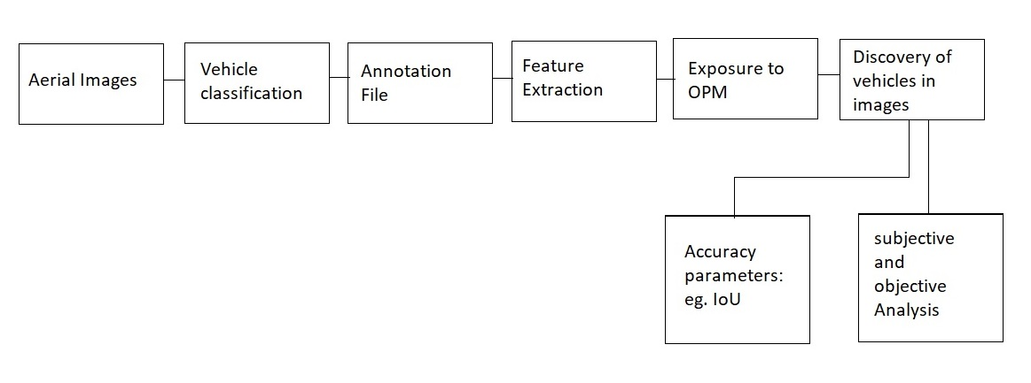
Block Diagram

Slide 6
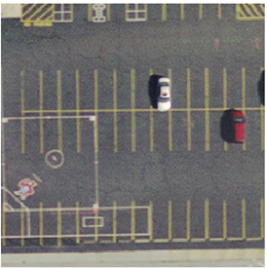
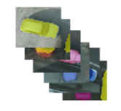
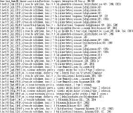
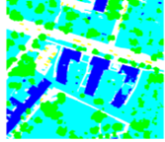
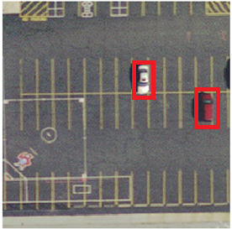
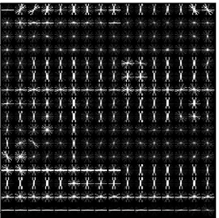
Aerial image
Vehicle
classification
Feature extraction
Annotation file
Accuracy determination
Objective and subjective
analysis
(Interface with other
systems like drones)
Discovery of vehicle
Exposure to OPM

Slide 7
Software Requirements:
Python 3.6 Idle
Open CV libraries
Numpy, matplotlib
Datasets : MUNICH Dataset
Anaconda

Slide 8
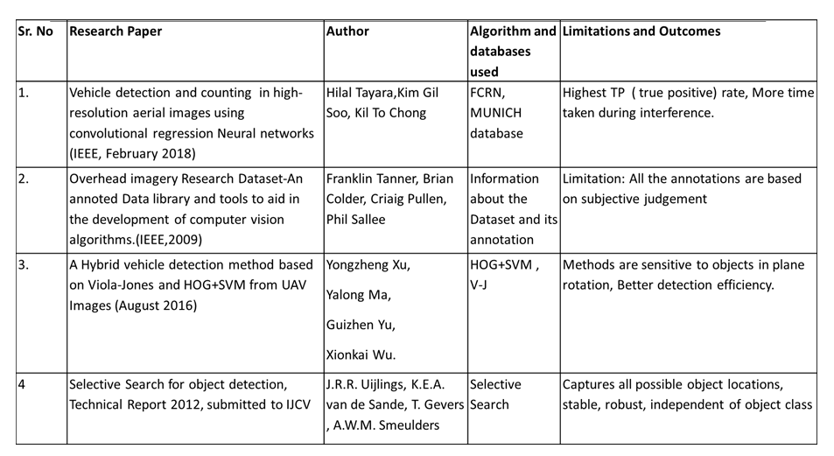
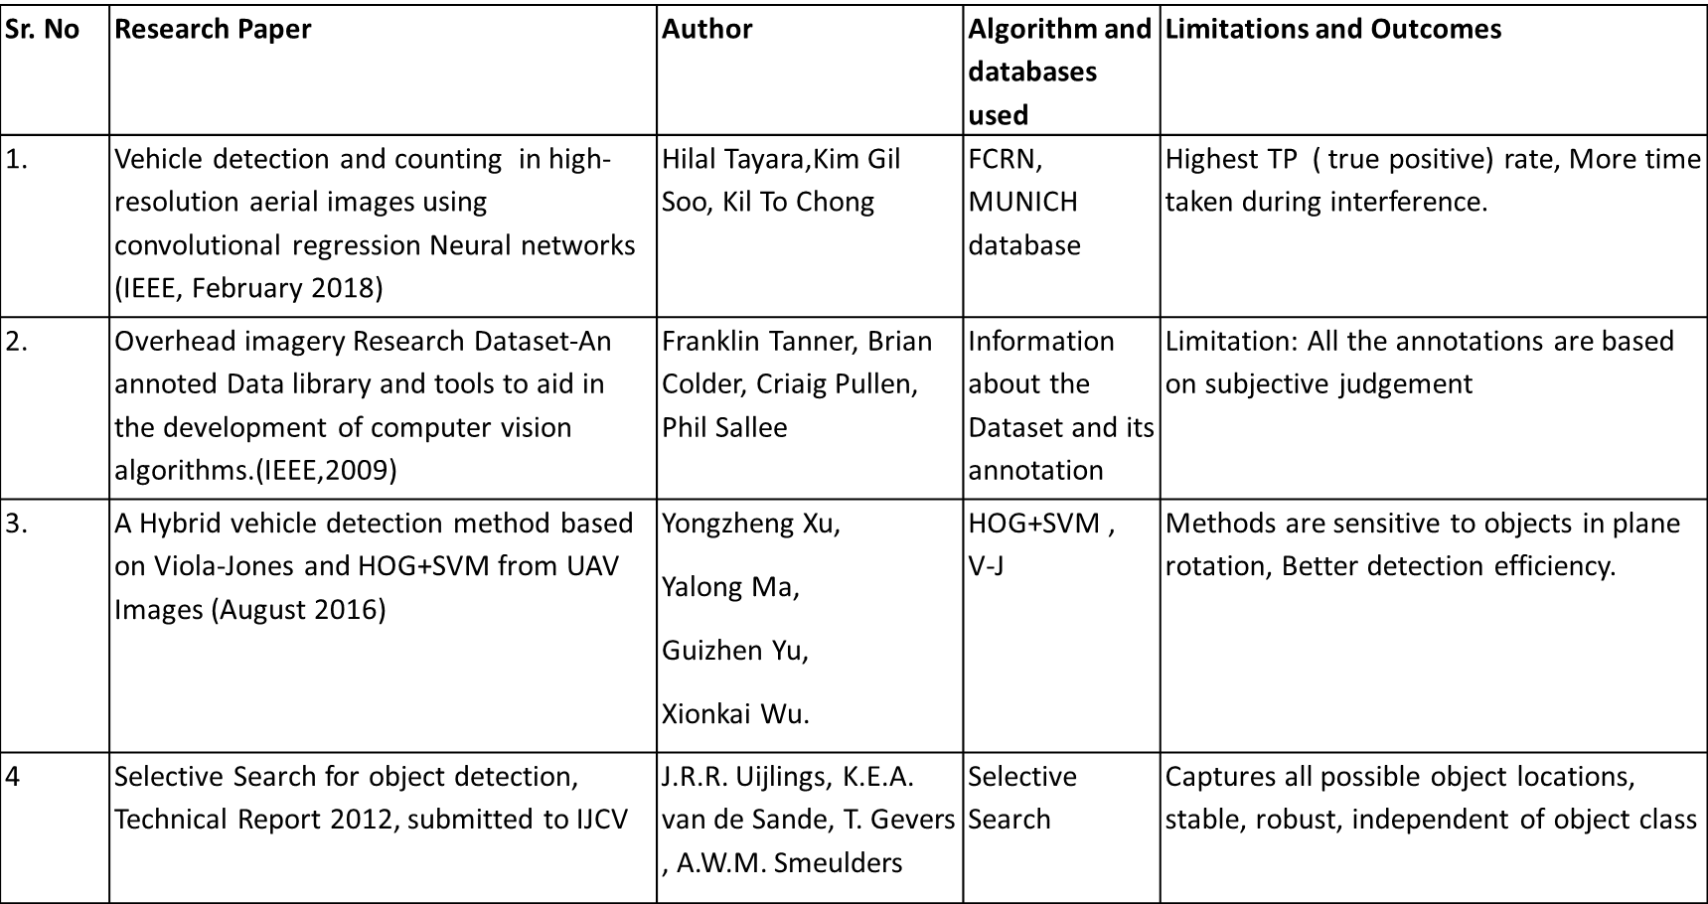
Literature Survey
All References to papers Are End of PPT

Slide 9
MUNICH and OVERHEAD Standard Database
Satellite captured aerial images
Total 907 images
Pixel resolution : 256x256
Size of an image: 190 to 570 KB
Images are taken at the height of 1000m above the ground cover area of the MUNICH city.

Slide 10
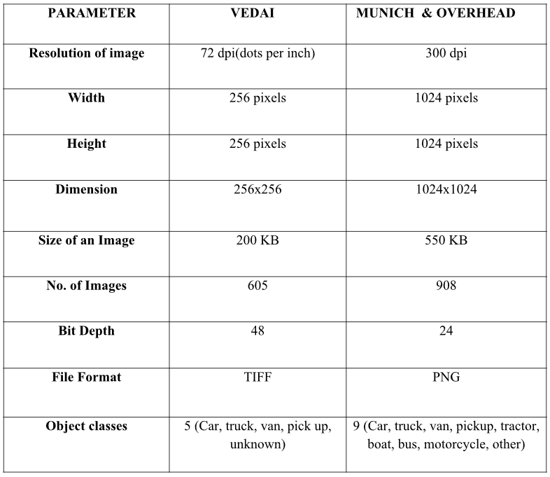
Choosing Datasets:

Slide 11
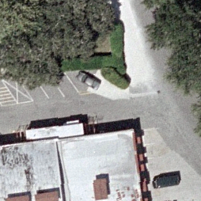
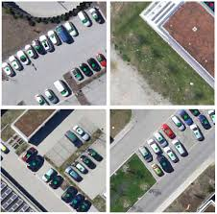
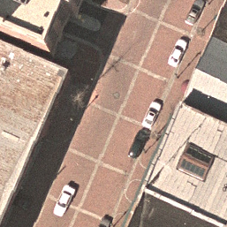
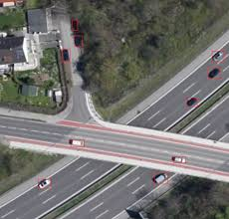
Images from MUNICH and Vedai

Slide 12
Image Segmentation:
Technique of dividing or partitioning an image into parts, called segments.
breaks the picture into a few parts based on certain picture highlights like
colour
Texture
pixel intensity
density
Processes only the important segments of the image instead of processing the entire image.
Useful for applications like image compression and object recognition.

Slide 13
Image Segmentation Techniques:
1. Threshold Method.
2. Edge based Method.
3. Clustering based Method.
4. Region based Method.
5. Watershed based Method.
6. PDE based Method.
7. ANN based Method.

Slide 14
Segmentation technique | Description | Advantages | Disadvantages
Thresholding Method | Peaks of image used to find histogram values. | Data from history not required. | Minute details not considered.
Edge Based Method | based on discontinuity detection | Better contrast. | Not suitable for images with to many edges.
Region Based Method | Image is partitioned according similar criteria | This method has better immunity towards noise. | Time and memory is wasted.
Clustering Method | Image segmented according to division into similar clusters | This method uses partial relationship. | determining membership function is not easy
Watershed Method | According to topological interpretation | Results are more reliable and trustworthy. | Calculations are time consuming
PDE Based Method | Image is segmented according to calculations of differential equations. | This method is very fast. | Complexity is more as compared to other methods.
ANN Based Method | Image is segmented according to the simulation of learning process used to make decisions. | Simple programs. | Time required is more.

Slide 15
Feature Descriptor:
Is an Algorithm which takes an image and outputs feature descriptors / feature vectors.
Feature descriptors encode interesting information into a series of numbers and act as a sort of numerical "fingerprint" that can be used to differentiate one feature from another.
For Example SIFT(Scale Invariant Feature Transform) , which encode information about the local neighbourhood image gradient.
Other examples HOG, SURF.

Slide 16
Feature Extraction:
Dimensionality reduction process, where an initial set of raw variables is reduced to more manageable groups (features) for processing.
reduces the amount of redundant data for a given analysis.
Challenges in Traditional methods:
Small size makes it complication for object localisation
Complex background
Multiple orientation
Lighting and Shadowing effect
Object similarities or repeated similar textures can bias the performance.

Slide 17
Feature Extraction Techniques:
1. Speeded-up robust features also called as SURF
2. HOG (Histogram of oriented gradients)
3. LBP (Local binary patterns)
4. Color histograms
5. Haar wavelets.

Slide 18
HOG:
The Histogram of Oriented Gradients (HOG) feature was developed by Dalal and Triggs.
The main principle of HOG descriptors is the identification of the appearance and shape of objects in an image by using the distribution of intensity gradients or edge directions.
In HOG, central horizontal and vertical gradients are computed with no smoothening.

Slide 19
Algorithm of HOG:
1. Global image normalization.
2. Computing the gradient image in x and y.
3. Computing gradient histograms.
4. Normalizing across blocks.
5. Flattening into a feature vector.

Slide 20
SURF:
Speeded up robust features (SURF) is a patented local feature detector and descriptor.
It is fast and robust algorithm for local, similarly invariant representation and comparison of images.
Used to locate and recognize objects, people or faces, to reconstruct 3D scenes, to track objects.
The main interest of SURF approach lies in fast computation of operator using Box Filters.
Thus enabling Real time application like tracking and object recognition.

Slide 21
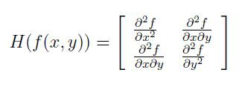
Steps in SURF:
1. Feature Extraction:
The approach for interest point detection uses a very basic Hessian matrix approximation.
2. Feature Description:
two steps for creation of SURF descriptor
fixing a reproducible orientation based on data from a circular region around the keypoint.
construct the square region at the same circular area aligned to the selected orientation.
Finally SURF descriptors are extracted.

Slide 22
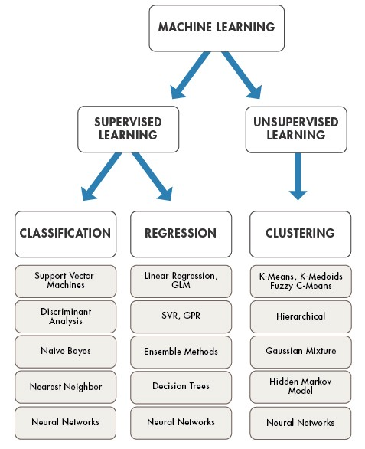
Model Implementation

Slide 23
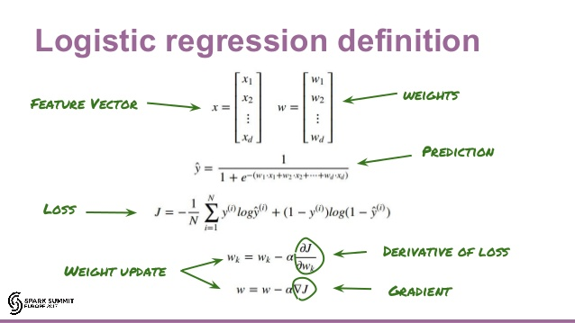

Slide 24
SVM
“Support Vector Machine” (SVM) is a supervised machine learning algorithm which can be used for both classification or regression challenges. However, it is mostly used in classification problems.
In this algorithm, each data item is plotted as a point in n-dimensional space (where n is number of features) with the value of each feature being the value of a particular coordinate. Then, classification is performed by finding the hyper-plane that differentiates the two classes very well.
Support Vectors: Input vectors that just touch the boundary of the margin
Margin of Separation : the separation between the hyperplane and the closest data point for a given weight vector w and bias b.

Slide 25
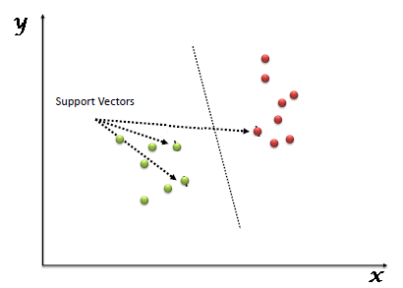
SVM Classification

Slide 26
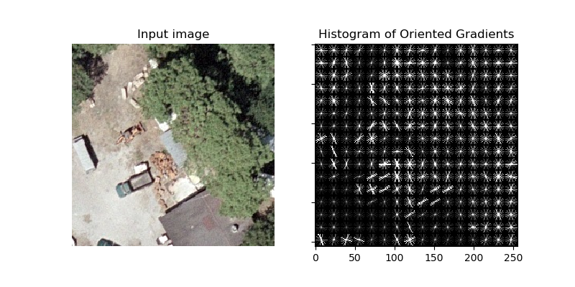
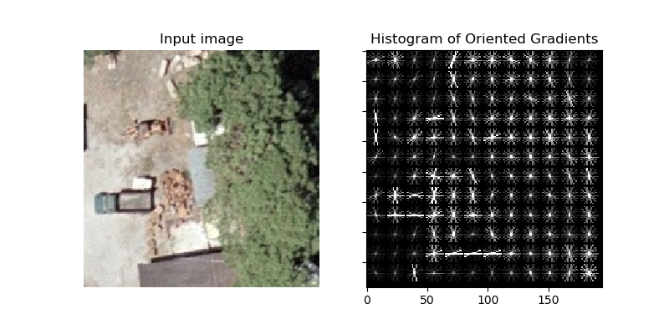
Result:
Original Image
Rotated Image

Slide 27
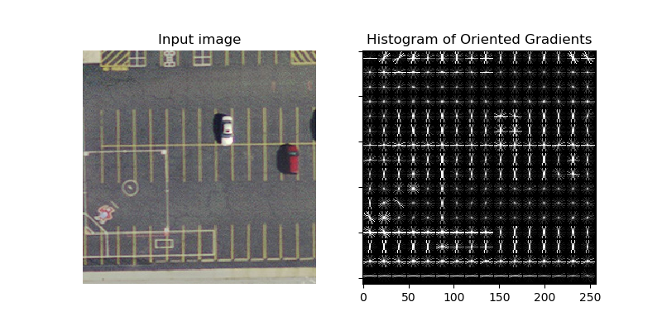
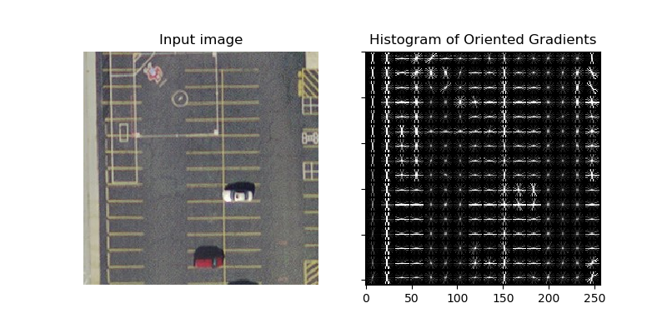
Original Image
Rotated Image

Slide 28
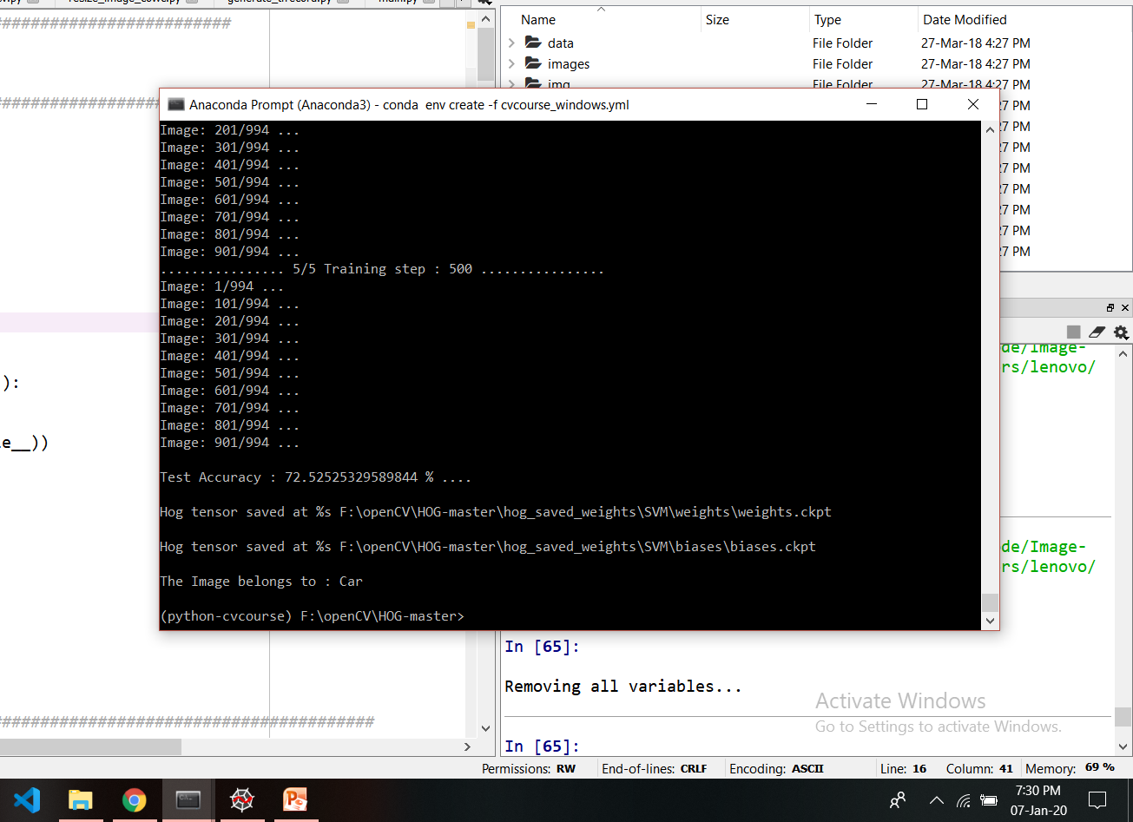

Slide 29
Statistical Results: HOG+SVM/LOGIST
Vehicle Class | SVM |  | LOGIST
 | 250 | 500 | 250 | 500
Car | 65.51 | 72.52 | 59.51 | 65.57
PickUp | 62.49 | 69.56 | 62.54 | 61.53
Truck | 69.54 | 64.54 | 69.55 | 68.54
Unknown | 69.54 | 67.57 | 58.53 | 69.55
Van | 66.56 | 63.53 | 59.51 | 70.62
Based on above result, it was concluded that the dataset training steps plays
essential role for training the model, apart from the quantity of the datasets.
SVM perform better than LOGIST for multiclass prediction, BUT still more accuracy
required if real time scenarios are to be handled.

Slide 30
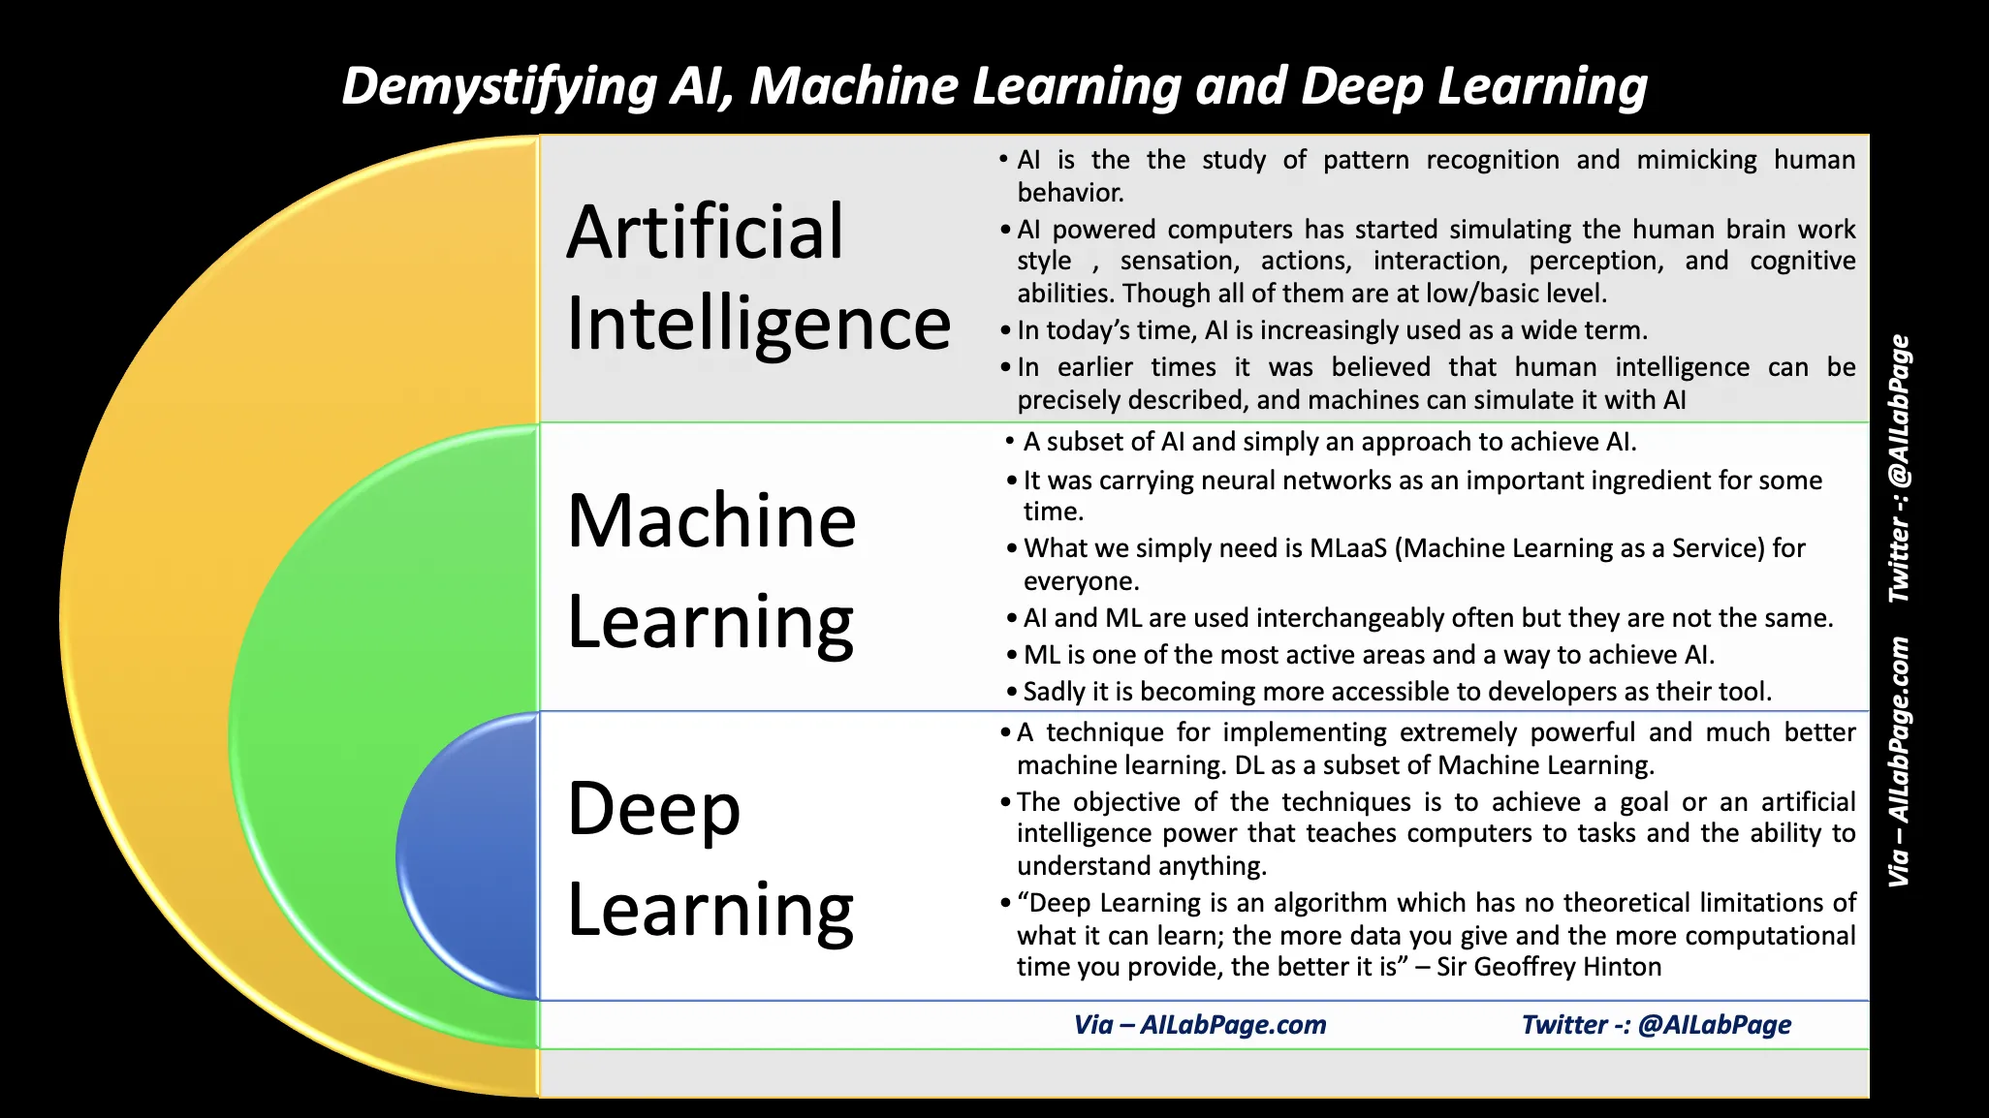
What Next?

Slide 31
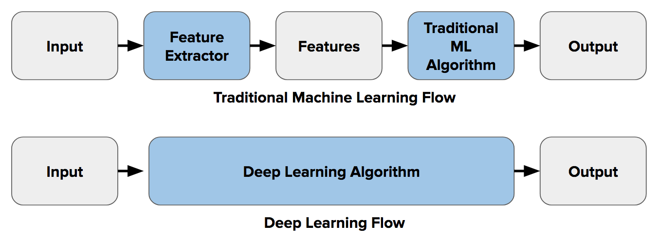
Moving towards DL

Slide 32
CNN
A Convolutional Neural Network is a Deep Learning algorithm which can take in an input image, assign importance (learnable weights and biases) to various aspects in the image and be able to differentiate one from the other.
Basic layers of CNN
Input layer
Convolutional layer/filter layer
Pooling layer, Flattening layer
Fully connected layer/feed forward layer
Output layer

Slide 33

Architecture

Slide 34
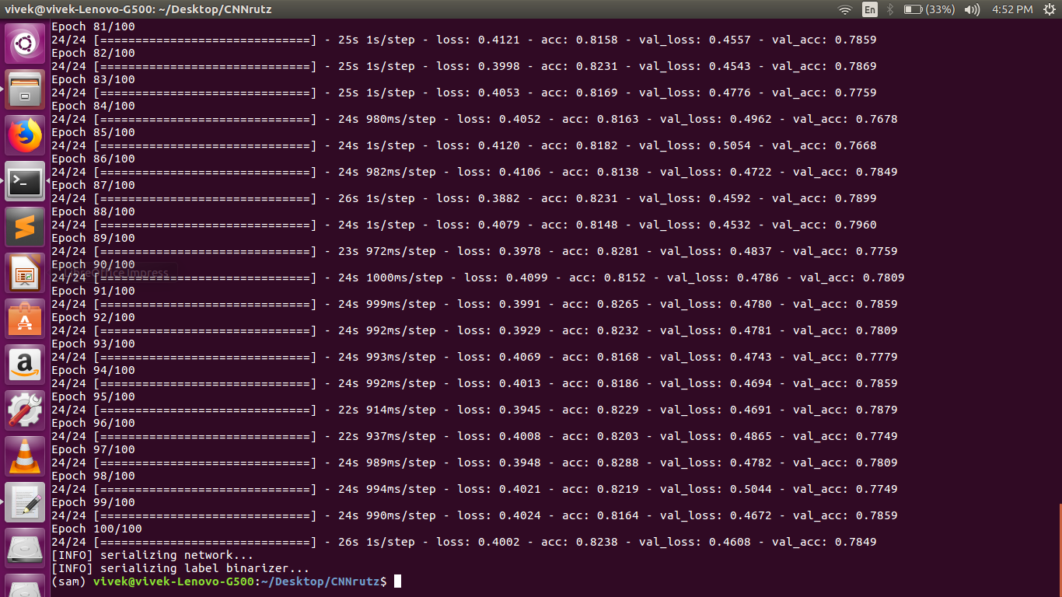
Continued…

Slide 35
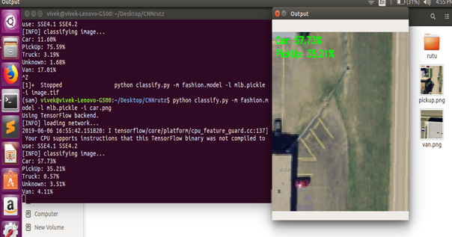
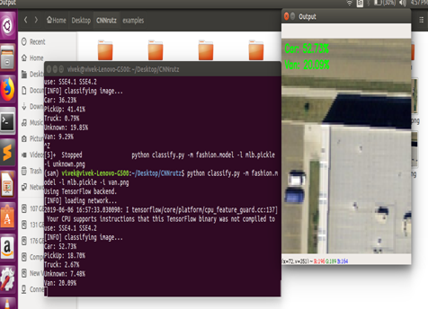
Result:

Slide 36
Evaluation Result
Method | Ground Truth | True Positive | False Positive | Recall | Precision | F1 Score | Time
ACP- Fast CNN | 5892 | 2583 | 1540 | 43.84% | 62.65% | 0.52 | 6.29s
Faster R-CNN | 5892 | 4050 | 503 | 68.74% | 88.95% | 0.78 | 3.84s
Proposed Model | 4000 | 3621 | 379 | 91.56% | 92.6% | 0.91 | 9.7s

Slide 37
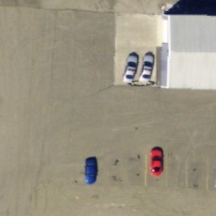
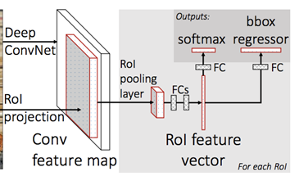
FRCNN
Labeling : Labeling is a graphical image annotation, in which the co ordinates of the objects are manually obtained by creating bounding boxes around the desired object.
Anchor boxes : Anchors are nothing but fixed-size rectangles to be fed to the Region Proposal Network. Anchors are defined over the last convolutional feature map.
Intersection over union : Intersection over Union is an evaluation metric used to measure the accuracy of an object detector on a particular dataset.

Slide 38
Progress of Project
DataSet:
After some literature survey on VEDAI and MUNICH, we selected MUNICH.
MUNICH dataset has more images that would help in working on more diversified data and also the environment of MUNICH dataset deals with more of the urban life scenarios.
Image Segmentation:
here it was clear that single method is insufficient for each type of image and not all methods are applicable for a single type of image.
Hence we decided to implement multiple segmentation technique based on type of image.
Various Segmentation algorithm were implemented watershed and edge-detection algorithm were selected.

Slide 39
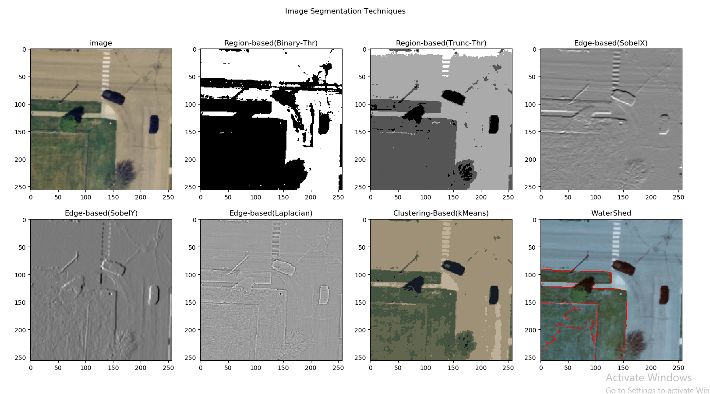
Image Clipped From Simulo App (Coming soon…)

Slide 40
Proposed Simulation Software
After Implementation of Machine Learning Models like
HOG + LOGIST
HOG + SVM
We learn concepts of hyper-parameter tuning and model performance improvement techniques.
later Deep learning Model were implemented and their performance was improved by further hyper-parameter tuning
We came to idea of building an Simulation tool which can be used to build NEURAL NETWORK and analyze performance by manipulating parameters.

Slide 41
Features
Dataset belonging to various category
For Regression purpose :-
plane separable dataset,
multi-Gaussian dataset
For Classification Purpose:-
Gaussian
Exclusive OR
Circular
Spirally distributed
Design Neural Network with 6-8 Hidden layers.
Support for 8 Feature in Input layer.
Manipulate weight and bias for any neuron in hidden layer.
Increase or decrease the number of neuron in hidden layer.

Slide 42
Continued…
Visualize individually the contribution of input feature neuron on NN graphically
Graphical visualization for Convergence of NN with parameter decided.
Hyper-parameter tuning for
Ratio of training to test
Noise
Batch size
Learning Rate
Activation function
Regularization
Regularization rate
Output Graph for Test Loss and Training Loss.
Darkening and lightening of link among Neurons according weights.
Play, Resume, Reset Button to run Epoch and textbox showing value of epooh.

Slide 43
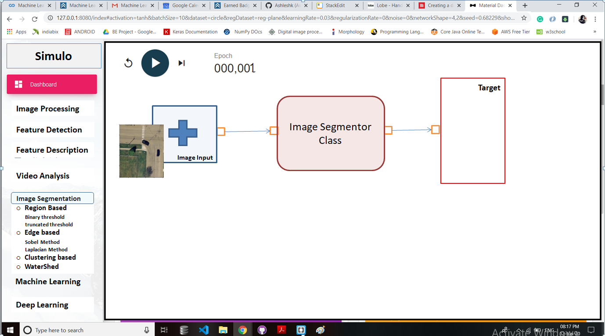
Giving Image to “Image-Input” Class

Slide 44
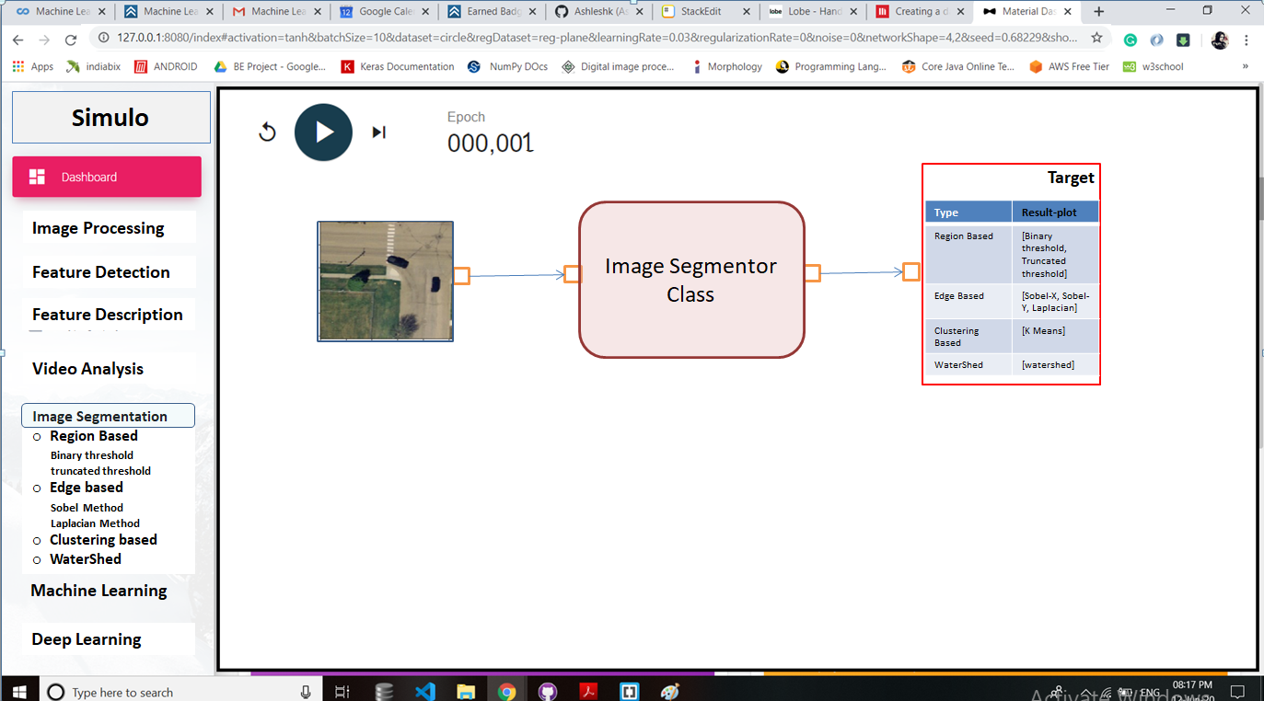

Slide 45
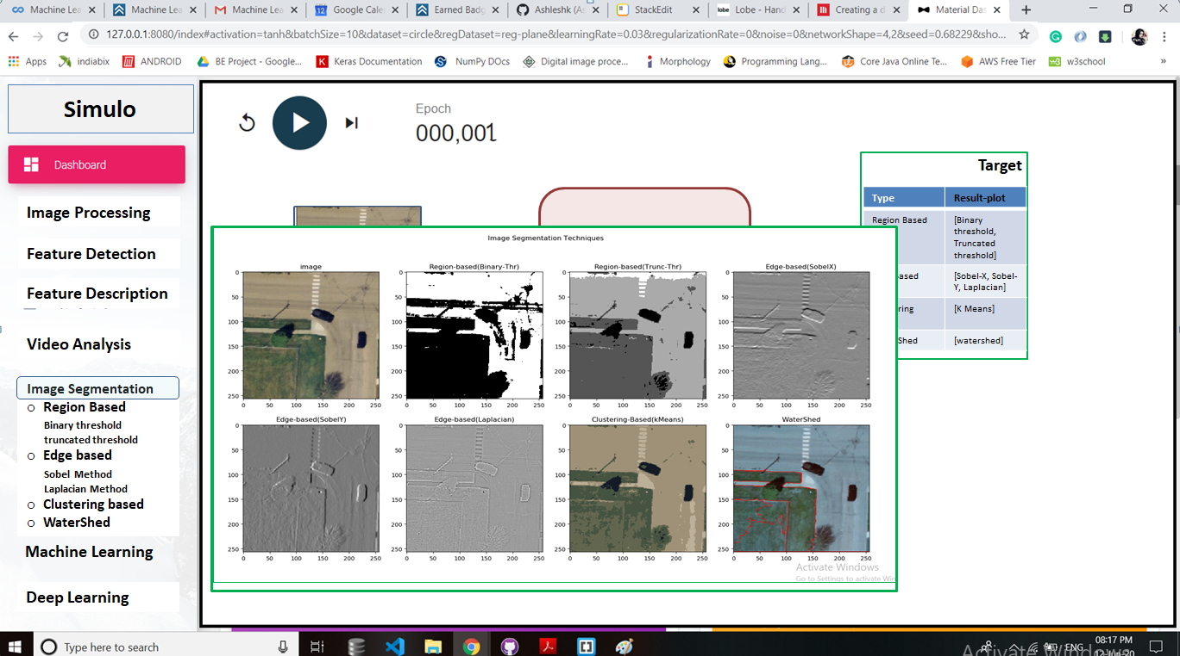

Slide 46
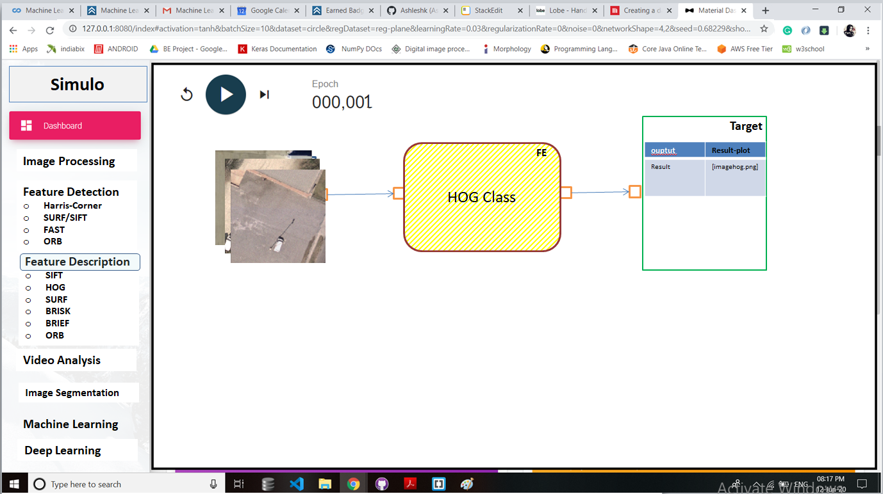

Slide 47
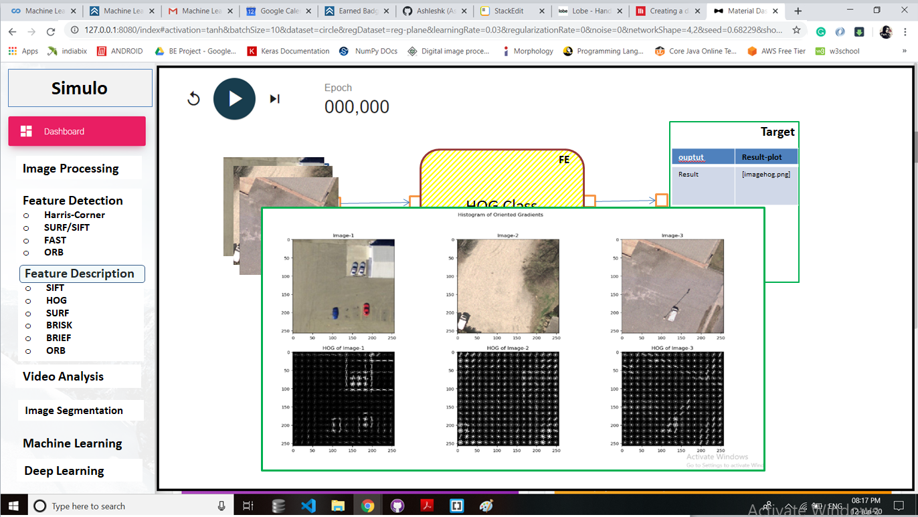

Slide 48
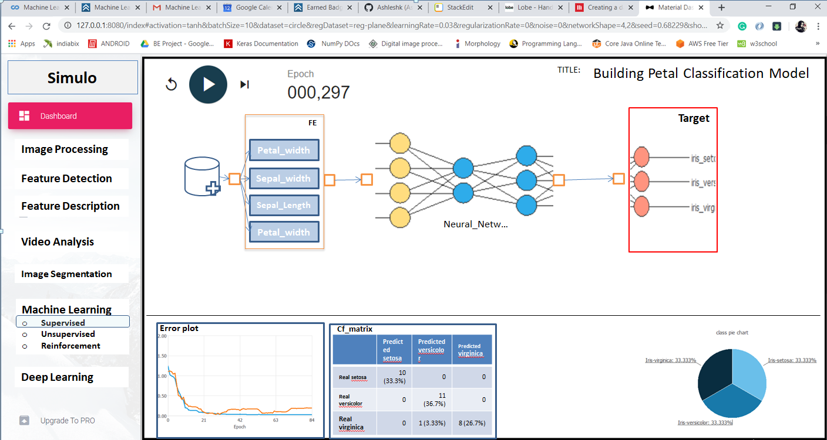

Slide 49
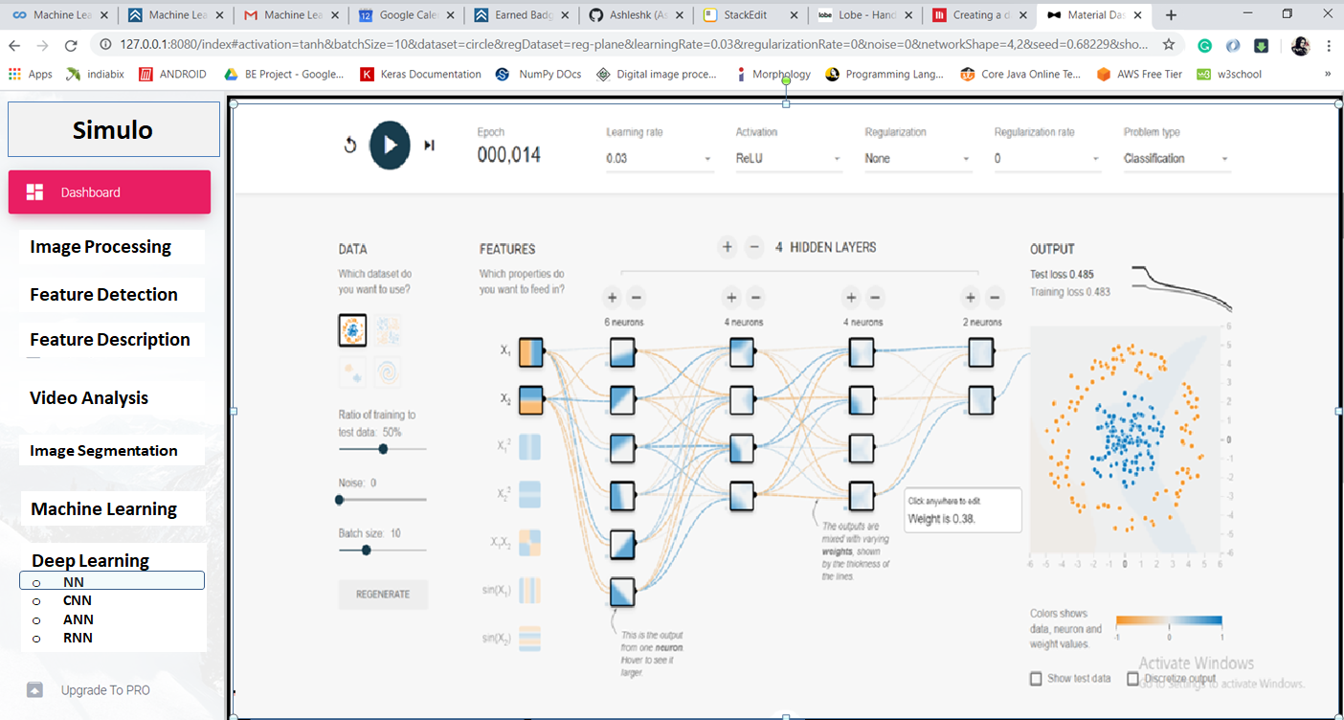
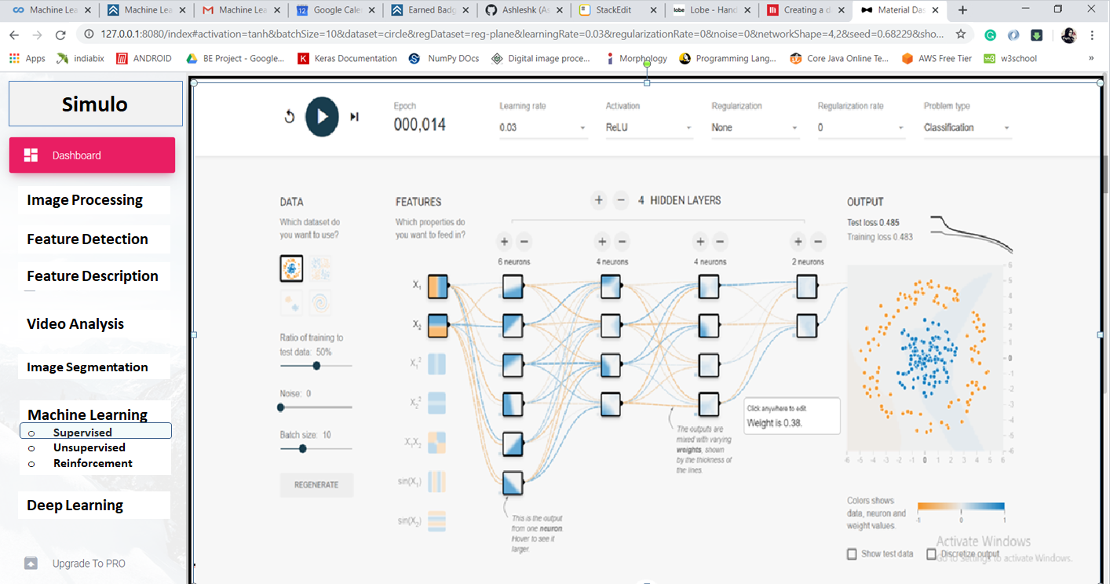
Classification problem,
Data-Circular

Slide 50
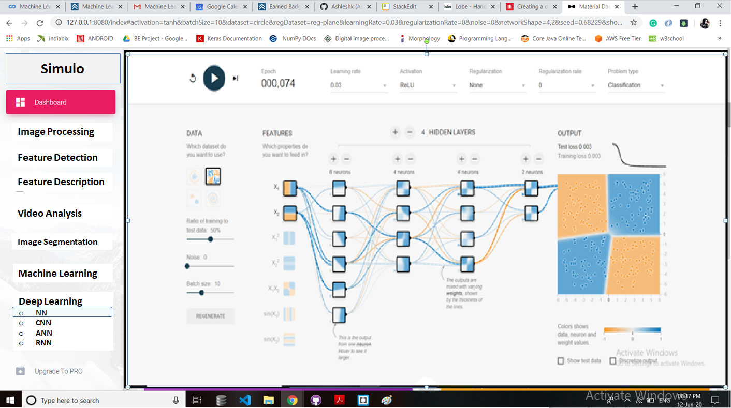
Classification problem,
Data-Exclusive OR

Slide 51
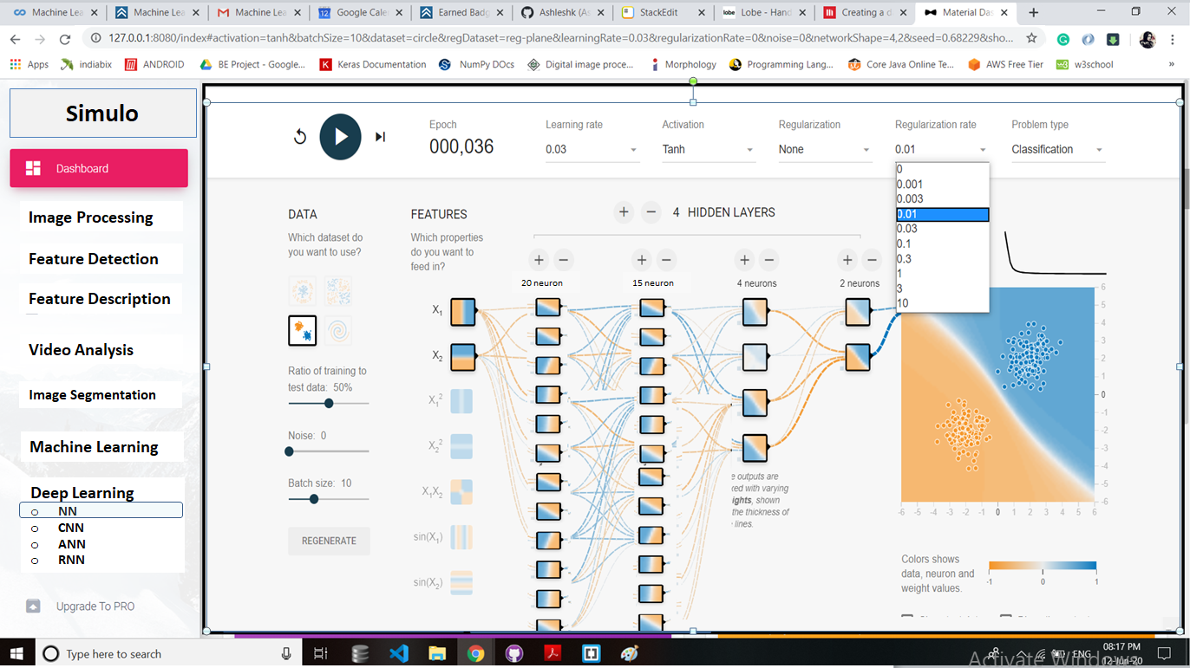
Classification problem,
Data-Gaussian (binary)

Slide 52
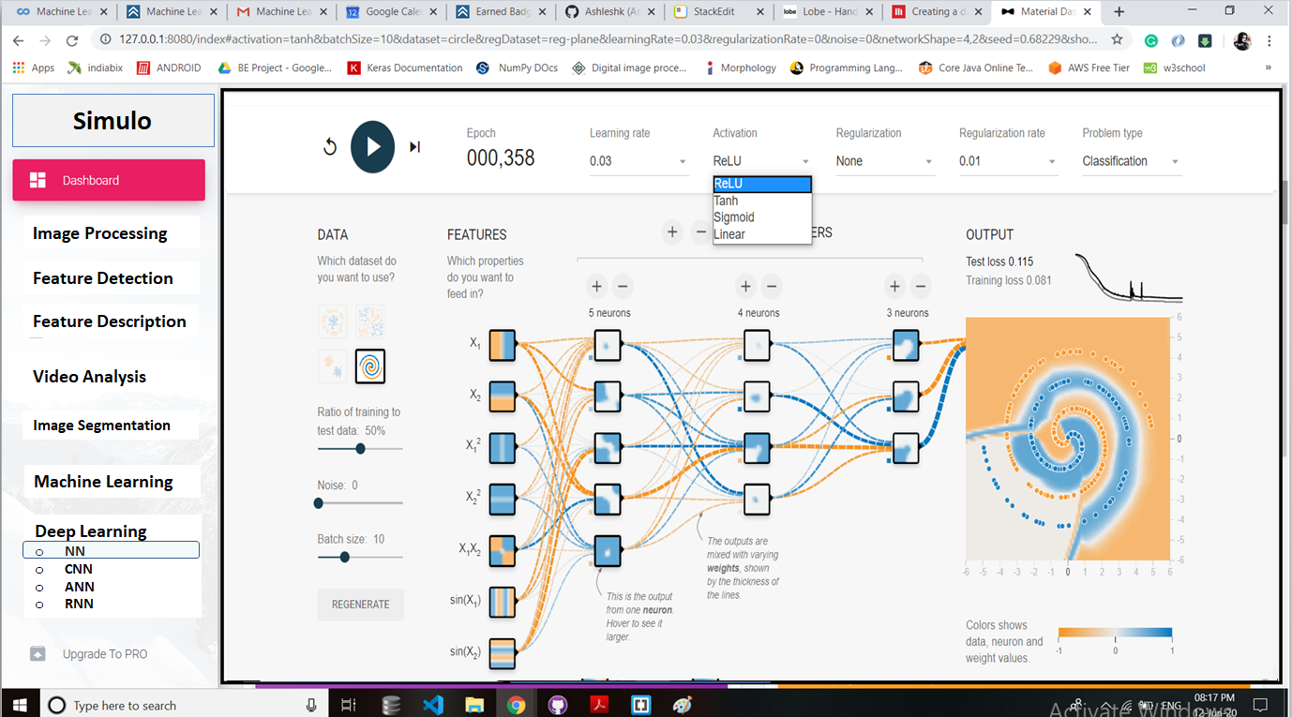
Classification problem, Data-Spiral

Slide 53
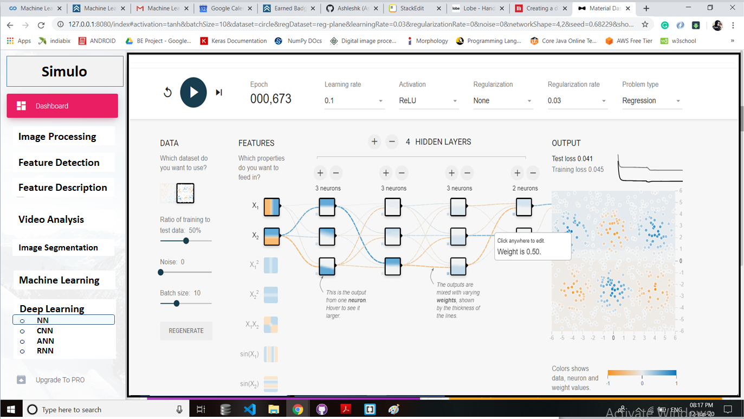
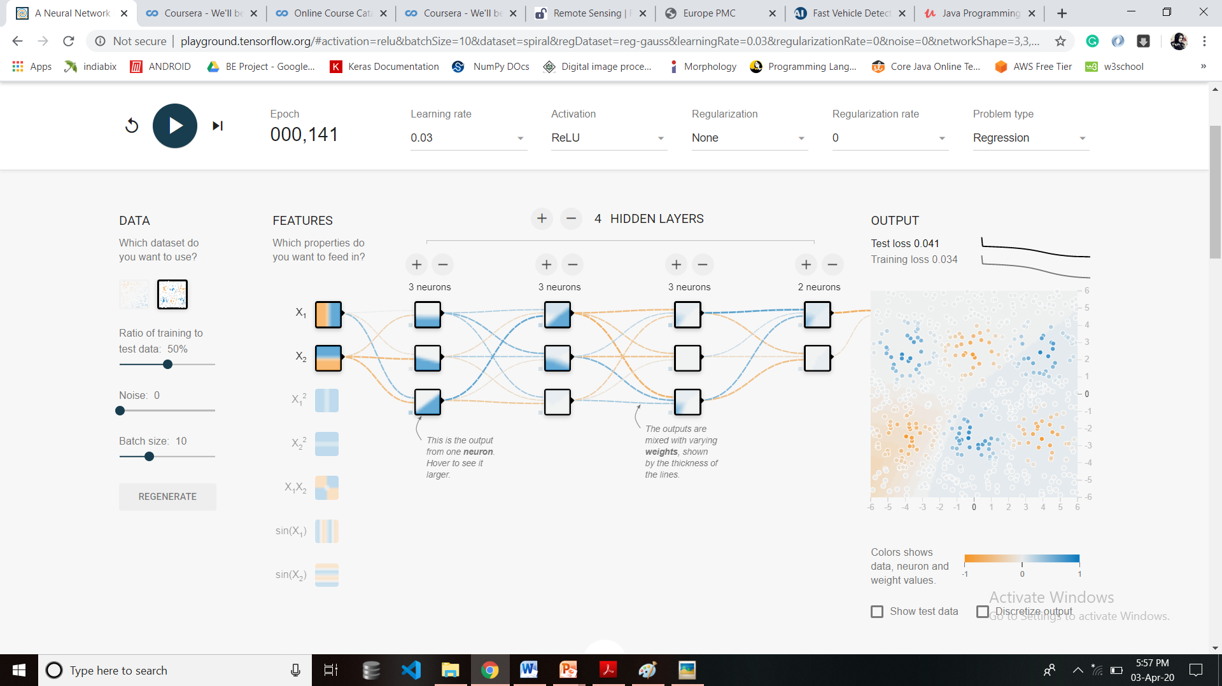
Regression problem,
Data-Multi-Gaussian

Slide 54
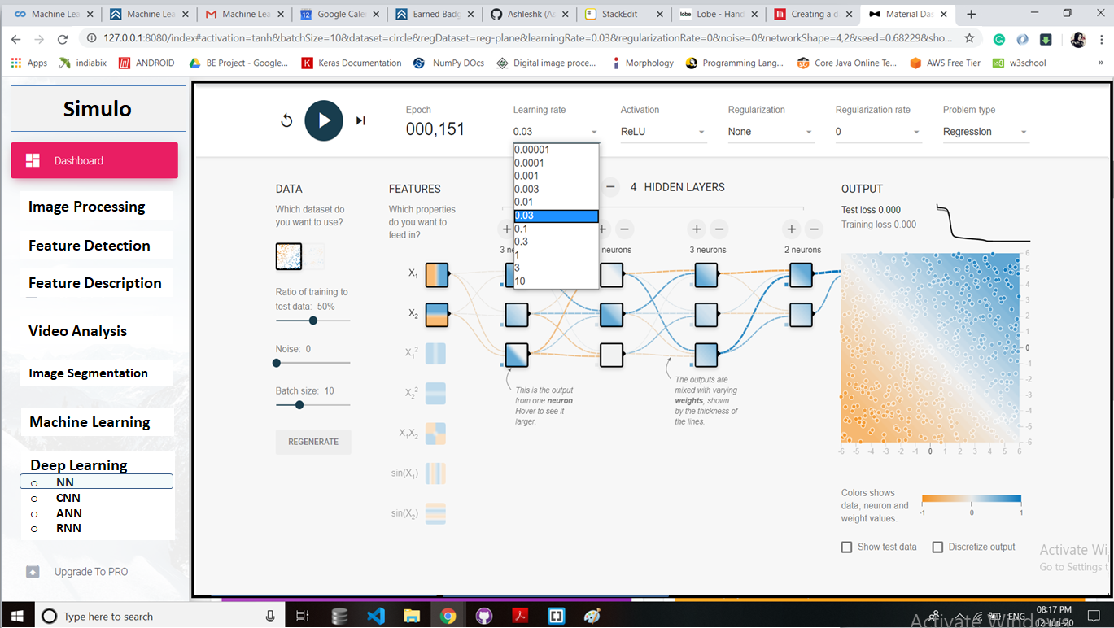
Regression problem,
Data-Plane

Slide 55
Continued…
Learning rate :- (10, 3, 1, 0.3, 0.1, 0.03, 0.01, 0.003, 0.001, 0.0001)
Activation:- (ReLU, Sigmoid, Tanh, Linear)
Regularization:- (L1, L2, None)
Regularization rate:- (10, 0.3, 0.1, 0.03, 0.01, 0)
Ratio of training to test data :- 0 to 100 % (slide-bar support)
Noise:- 0 to 50 % (slide-bar support)
Batch size:- 0 to 200 (slide-bar support)

Slide 56
Conclusion:
Precisely, we concluded that MUNICH is a more needful and convenient database over the other available databases like the VEDAI etc.
all the methods learnt are suitable for a certain image type and no single method is sufficient for each and every image type.
Implementation of multiple segmentation methods result in more accurate result for object detection.
switching strategy, combined with the road orientation adjustment method, can significantly improve the efficiency and effectiveness of the vehicle detection from Aerial images.
After a detailed study using various papers we concluded to first work on the dataset using the HOG+SVM algorithm. The final accuracy obtained was 72.8% approximately.
Later we moved to work on CNN for an improved accuracy using which we obtained an accuracy of 92.53%

Slide 57
Simulation Software for free-hand designing of neural network of Deep learning with support of Hyper-parameter tuning was developed.
Successful results were achieved in terms of simplified analysis of neural network
impact of every neuron in prediction of output was graphically visualized.

Slide 58
Future Scope:
Learn and analyze the result of various Feature Extraction algorithms.
Explore result of feature extraction and classifier on different datasets.
Study of more Classifiers which are used for classification of detected vehicles or objects into various classes more accurately and efficiently.
Support for various ML and DL Algorithm in Simulation software apart from current NN support.
To build drag-and-drop blocks of algorithm and analyze accordingly.
Real-time aerial image analysis.
On successful execution of the software part we would further interface the system onto a drone and try to capture real time images and try out its various applications as mentioned earlier.

Slide 59
Applications:
To locate the densely and sparsely vehicle populated areas and thus use it for runtime traffic analysis on a larger scale
To detect parking lots
Automatic parking lot classification
Enhancing road maps by parsing aerial images around the world
Enable User to Design Their Own Model And Simulate in Prior to actual Development.
Clean Overview, better Understanding of Concepts of ML, DL and AI Algorithm.

Slide 60
References:
1)Hilal Tayara, Kim Gil Soo,Kil To Chong,”Vehicle Detection and Counting in High resolution Arrial images using Convolutional Regression Neural Network”, volume 6, IEEE,current version February 14,2018.
2)Franklin Tanner , Brian Colder,” Overhead imagery research dataset- an annotated data library and tools to aid in the development of computer vision algorithms”, IEEE 2009.
3)Yongzheng Xu, Guizhen Yu,” A hybrid vehicle detection method based onn Viola-Jonnes and HOG+ SVM from UAV images, 20 June,2016.

Slide 61
4) Yongzheng Xu, Guizhen Yu, ” A vehicle detection method based on Viola-Jones and HOG combined with SVM from Unmanned Aerial Images”, Jiangsu province Collaborative Innovative conference, Nanjig, China, June 2016.
5) Alex Krizhavsky, Ilya Sutskever and Geoffrey E. Hinton, “ImageNet classification with deep convolutional neural networks”, Proc. IEEE Convoultional Neural Networks and Deep Learning, July 2004, pp564-568, Oct 2001.
6) Herbert Bay, Tinne Tuytelaars, and Luc Van Gool, “SURF: Speeded Up Robust Features” ,ETH Zurich, Tech Rep TR-948(0034)-4, July 2008.
7)Rafael C. Gonzalez and Richard E. Woods, “Digital Image Processing”, Publishing House of Electronics Industry, Changping, Beijing, Tech Rep. Jan. 2007.

